Slide 1
Remotely sensed hyper-spectral signatures as indicators of biodiversity
Shawn Schneidereit
Image credit: WMAC(NS)
Notes:
https://wmacns.ca/yukon-north-slope/land/herschel-island-qikiqtaruk/

Slide 2
Why do spectral signatures matter?
One in five plant species are categorized as threatened
Need efficient monitoring of changes in biodiversity
Remotely sensed spectral data has potential to be a cost-effective efficient technique to monitor real-time changes on an ecosystem or even global scale
(Cavender-Bares et al., 2017)

Slide 3




The spectral diversity hypothesis
The spectral diversity of an area is an expression of vegetation biological and functional diversity
Spectral diversity
Richness
(Gholizadeh et al., 2018).

Slide 4
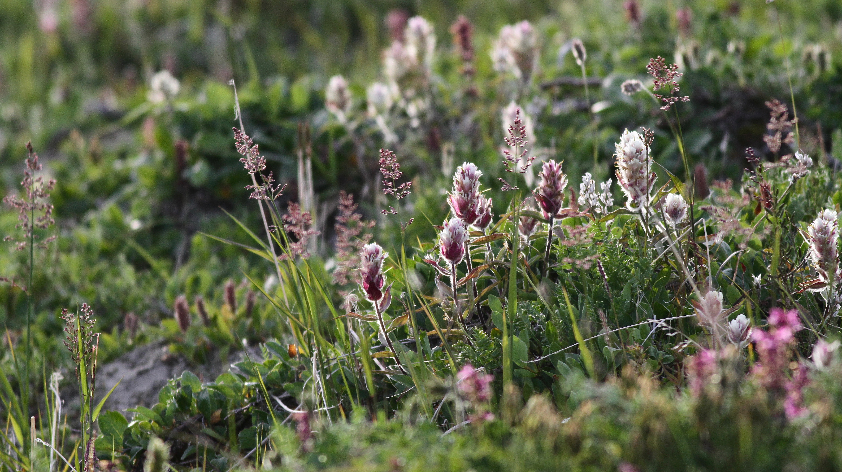
Knowledge gaps
Generally at local scales spectral diversity increases with biodiversity
Does this trend hold true at increasing scales of observation?
How do spectral signatures and biodiversity estimates vary across scales?
While not currently possible at satellite scale (MODIS I), can biodiversity accurately be mapped at regional levels using UAV or plane derived data?
Image credit: Gergana Daskalova

Slide 5
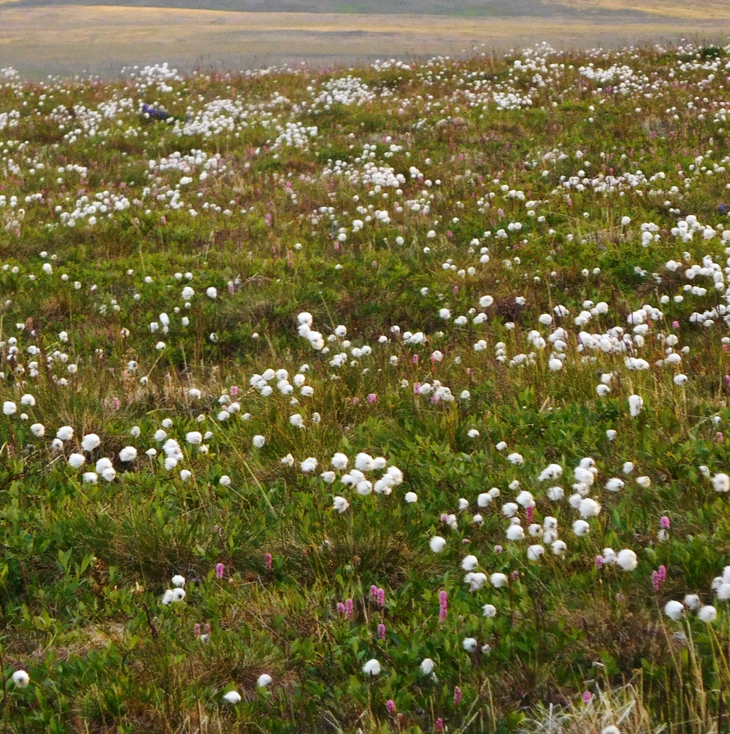
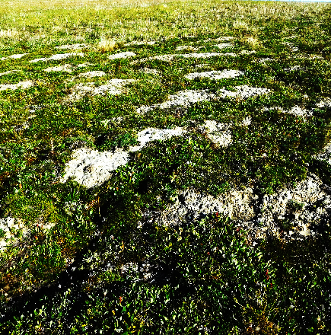
Research Question I
Do Herschel and Komakuk vegetation types differ in their hyperspectral signatures?
Herschel type
Komakuk type
Notes:
The first question of whether Herschel and Komakuk vegetation types differ in their hyperspectral signatures can be answered using data obtained at a plot-scale or plane-scale. Overall plane-scale is currently the preferred means of analysis, as this could establish valuable precedence for further research. Here the variance in spectral diversity of Herschel and Komakuk vegetation will be compared, using an existing mapping of the vegetation types present on Qikiqtaruk (Obu et al., 2017).

Slide 6
Research Question II
How do hyperspectral signatures relate to species richness & evenness, canopy cover, and percent bare ground?
Shrub et al.
Species richness
(Gholizadeh et al., 2018).
Notes:
How hyperspectral signatures relate to species, richness & evenness, canopy cover, and percent bare ground will be primarily answered with plot level data. Initially biodiversity indices will be as basic measurements of richness & evenness. Pointframing data can be used for the identification of species, aswell as canopy cover and percent bare ground. Furthermore, principle component analysis can be conducted to see which variable explains the greatest variability within observed hyperspectral signatures.

Slide 7
Research Questions III & IV
3) At what scale/resolution (Site, drone, Plane) can remote sensing data be applied before the stated hyperspectral relationships can no longer be observed? What is the variance in accuracy?
4) Can spectral diversity be scaled beyond individual vegetation communities? Can local or regional mappings be produced of ie. richness?
(Wang, 2017)
Notes:
Previous studies indicate a strong scale-dependence of the relationship between spectral diversity to biodiversity. Therefor this study will assess the relationship between hyperspectral variability and biodiversity at three spatial scales: i) plot-scale, ii) drone scale, and iii) plane-scale.
There for all spatial scale will be used to assess the impact of resolution on the observed hyperspectral relationships and if data saturation across scales occurs. This will also provide insight into the variance of accuracy between sensed spectral signatures and the biodiversity estimates at different spatial scales.
At the larger remotely sensed scales of observation, bare ground is likely to be a significant predictor of variance in spectral diversity (Gholizadeh et al., 2018). A potential approach to assess the significance of this variances to overlay plane hyperspectral raster data over the already mapped % bare ground obtained from previous years drone imagery.
At the plane scale , hyperspectral signature variance will be related to veg type, topography, wetness, (and possibly slope and aspect?). The topography Qikiqtaruk is available via the Arctic DEM dataset and wetness, slope and aspect can all be derived/interpolated from DEMs

Slide 8
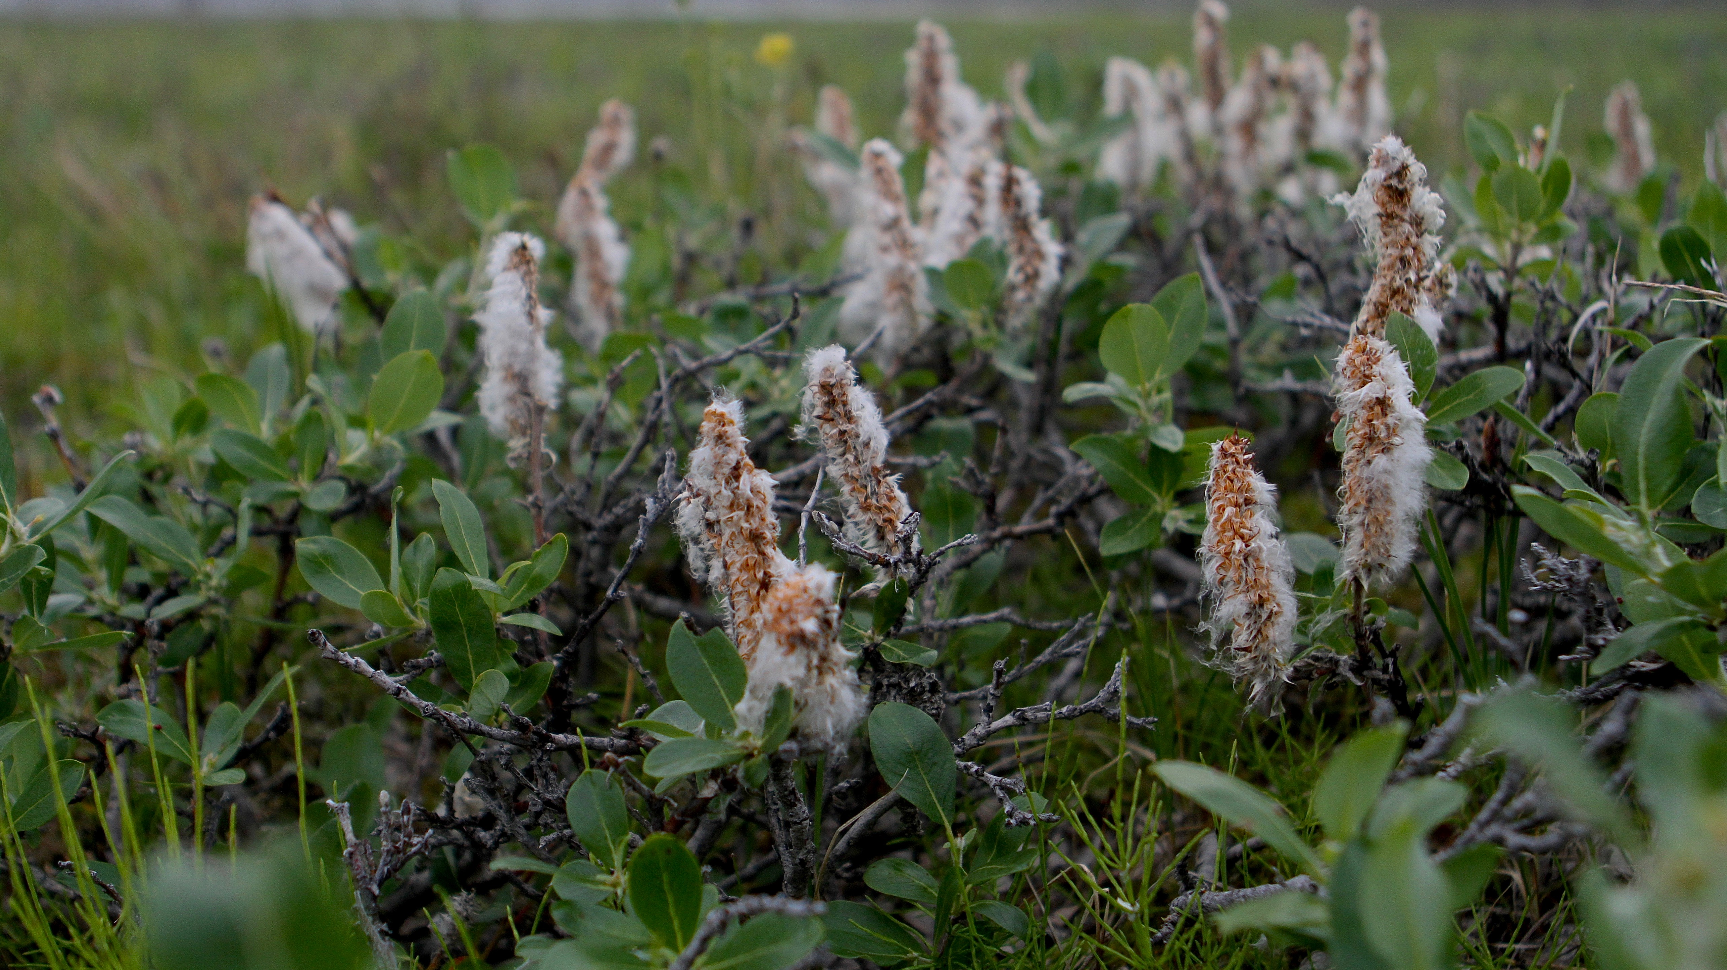
Conclusions – Q&A
Pairing field and remotely sensed measurements has the potential to be an efficient and novel method to assess biodiversity
Remotely sensed hyperspectral imagery could be a novel and spatially scalable methods to assess the biodiversity of vegetative communities
Supporting evidence of the spectral diversity hypothesis must be prided, as well as observation variance between spatial scales, and the impact of abiotic correlates
Image credit: Gergana Daskalova
Notes:
Pairing field measurements with remotely sensed multispectral imagery presents itself to become a cost and time efficient way to assess biodiversity. Critically, it can provide a scalable method of environmental measurement, capable of sampling greater spatial areas than possible with conventional ground-based methods. The potential exists for remotely sensed spectral analysis to, through the use of improving satellite technology, to assess changes in biodiversity and ecosystem composition across time, on a global scale.
This study can be used to guide further effort of using remotely sensed data to assess biodiversity. (Hopefully) a model of how hyperspectral diversity relates to biodiversity, is presented and how abiotic factors such impact spectral signatures and the associated biodiversity estimates. also aids in developing the methods and infrastructure required for the effective scaling assessing biodiversity remotely.

